Slide 1










ACADEMIC RESEARCH RECOMMENDER SYSTEM
Group ID : 202108
HYPERCORRECT
Anıl Mithatcan AKBAŞ 201811001
Başak ÇAVUŞDAĞ
Berkan Taha ÖZDEMİR
201711014
201811402
Ceren AKKUŞ 201711401
Advisor: Assist. Prof. Dr. Uğur SOPAOĞLU

Slide 2




Table of contents
01 | 02 | 03 04
Problems | Our Difference | Technologies AI
05 | 06 | 07 08
User Interface | Use Case Diagram | Potential Conclusion Risks

Slide 3





Introduction
Academic research recommender systems can provide researchers with accurate and relevant papers in no time.

Slide 4













01
Problems

Slide 5






Problems
Increase in the number of papers published
Waste of time
Information Pollution

Slide 6








02
Our Difference

Slide 7






Our Difference
Customized Per Person Filters
Vote the Papers
Personalized Paper Recommendation
Receive Recommended Papers by Email

Slide 8
















0 3 Technologies

Slide 9
Dataset
Paper
id, title, abstract, published_date, authors, pdf_url, github_url, tasks
Crawler/Parser
Task
task_id, task_name, description, area_id
Area
PapersWithCode
area_id, area_name
Dataset

Slide 10
04
AI

Slide 11
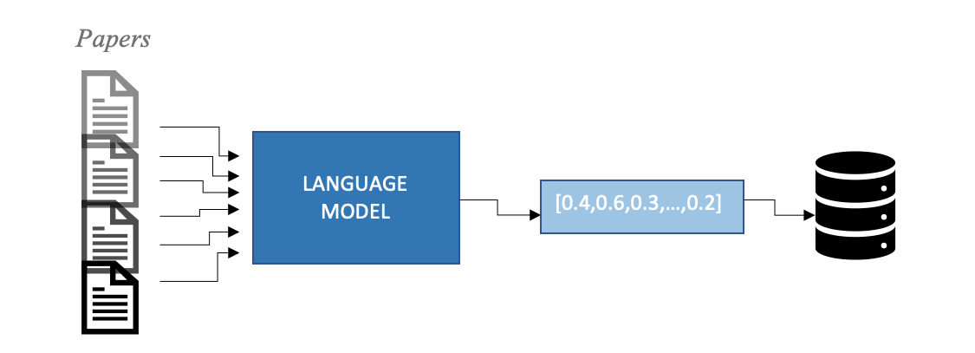
AI

Slide 12
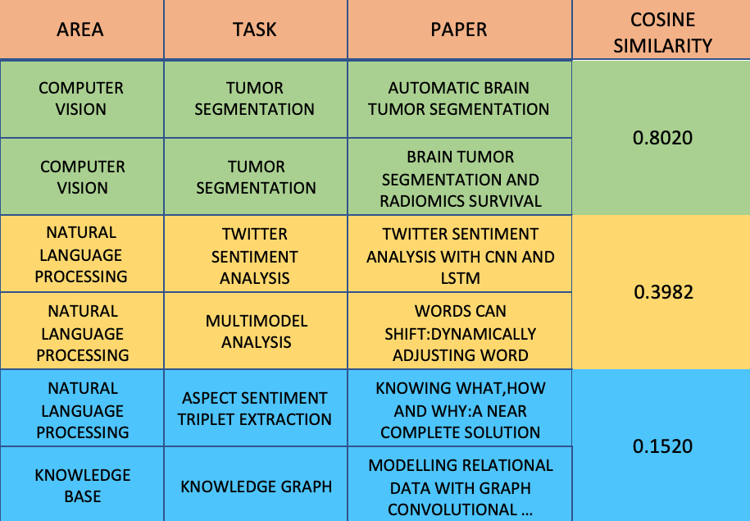

Slide 13
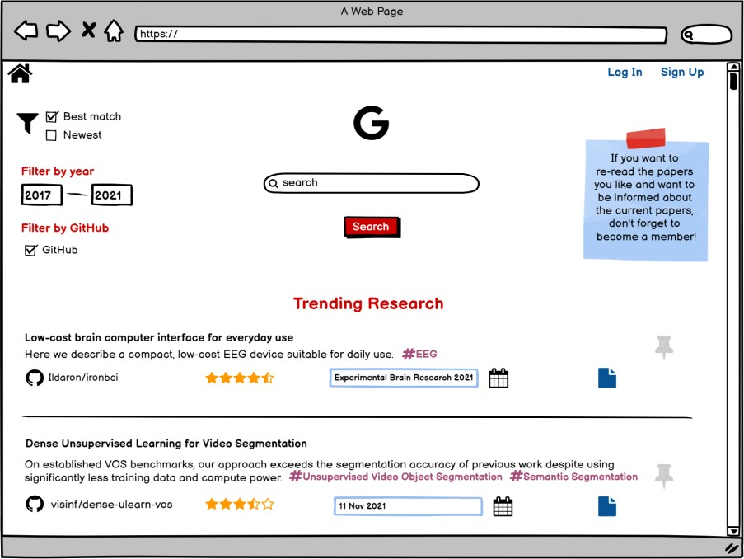


05
HYPERCORRECT
User Interface

Slide 14
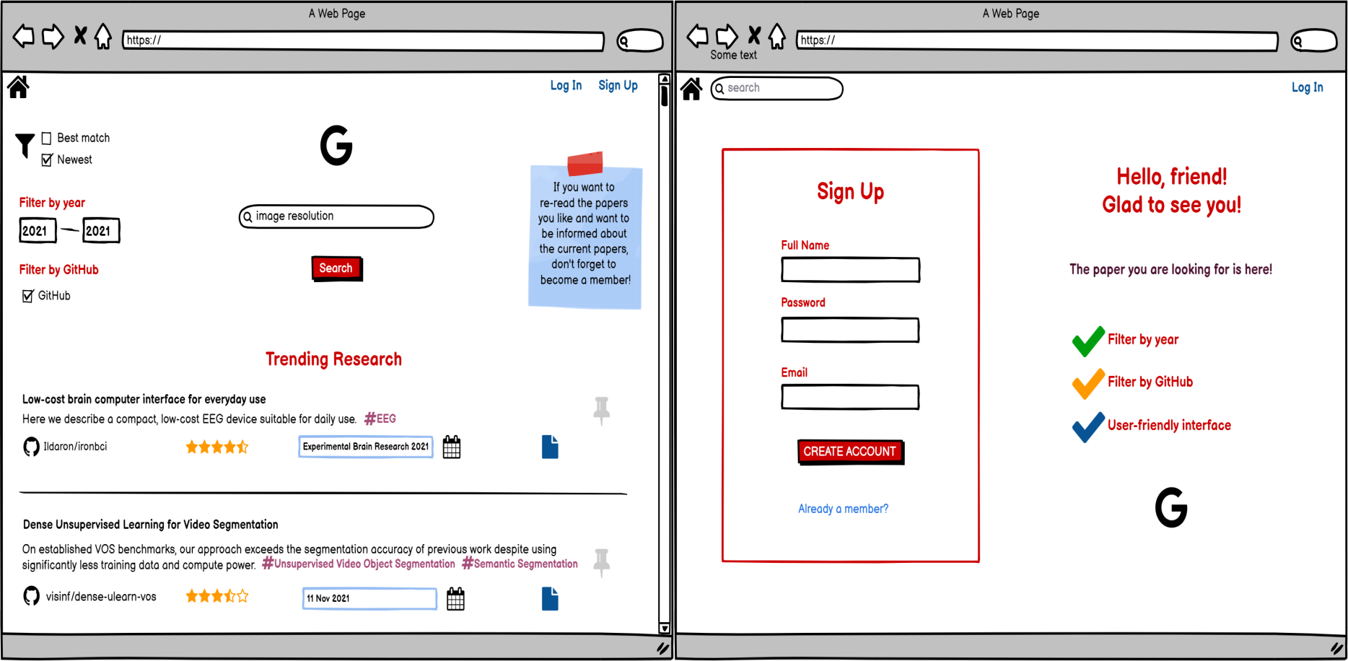




Slide 15
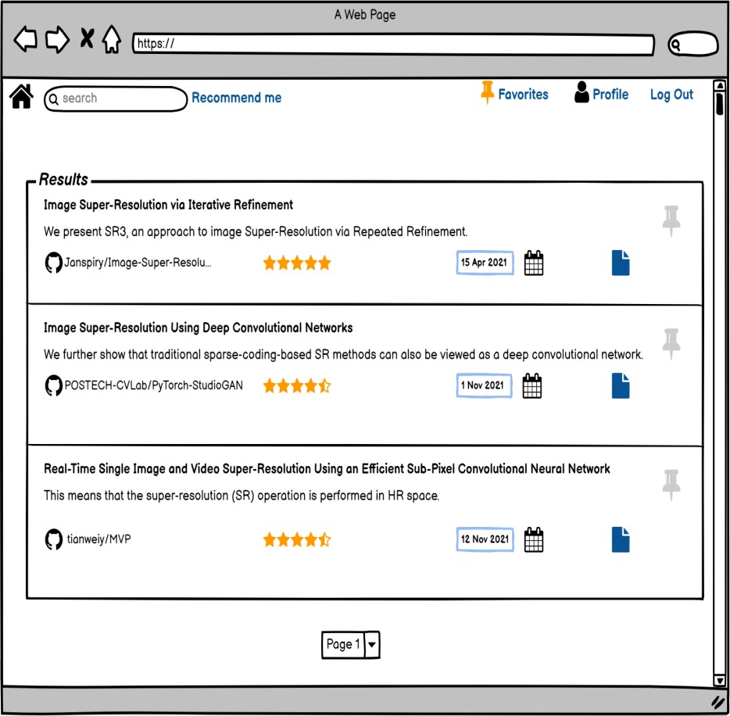
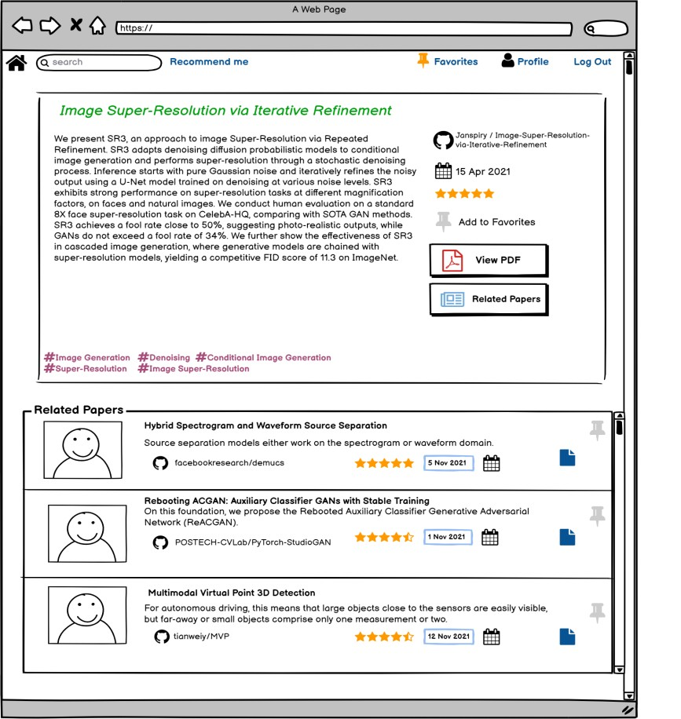

Slide 16
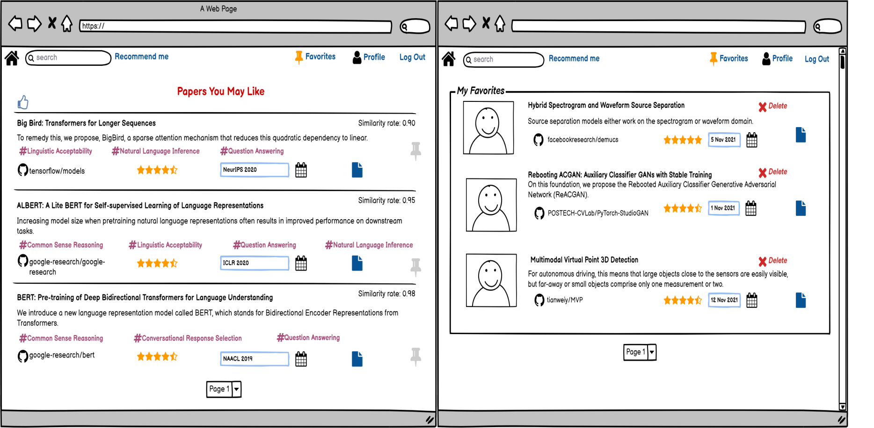

Slide 17
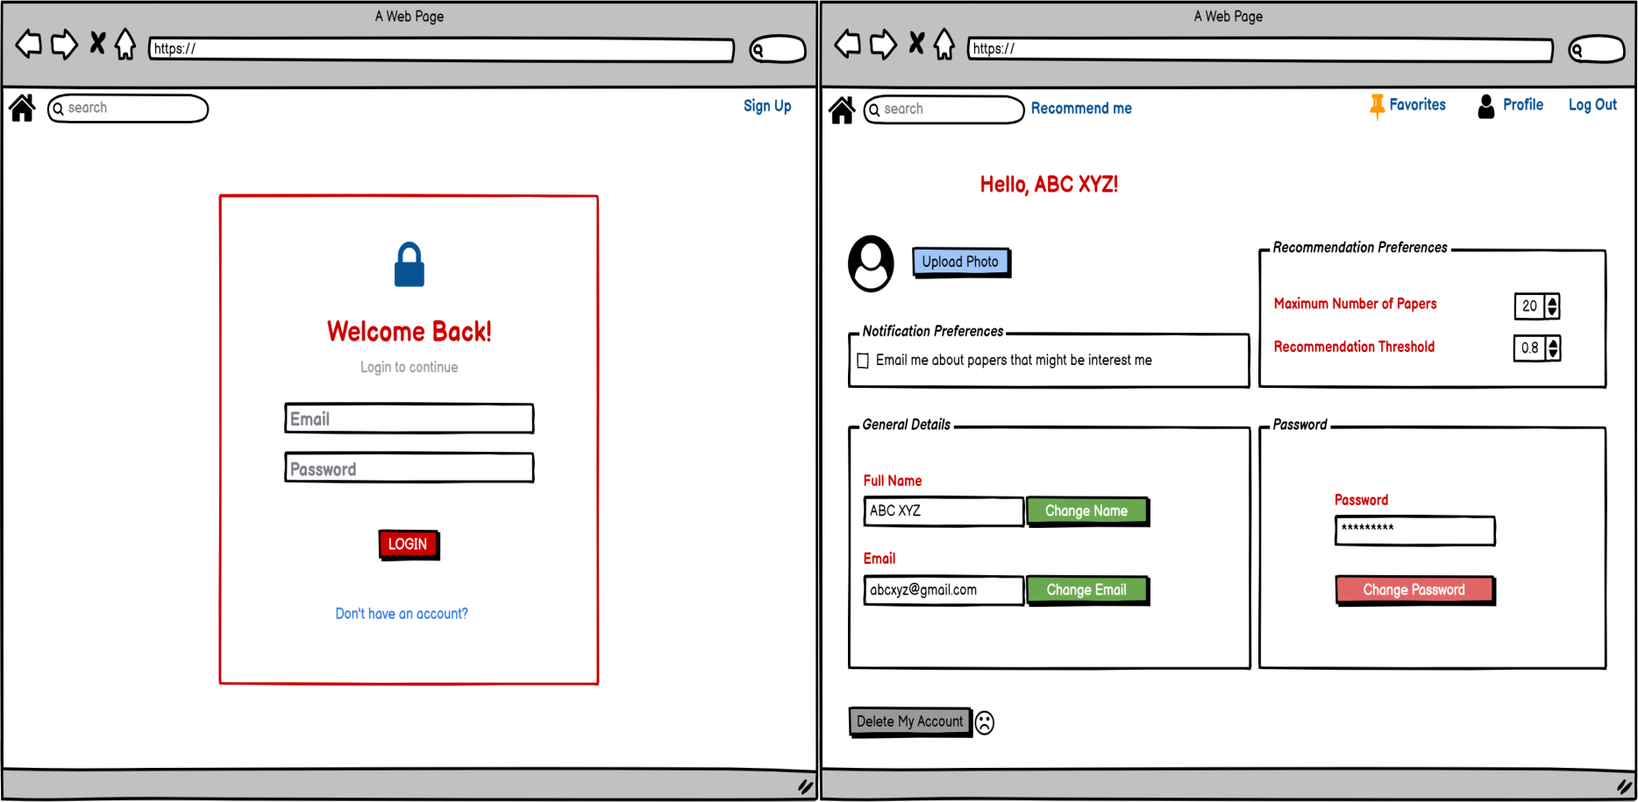

Slide 18
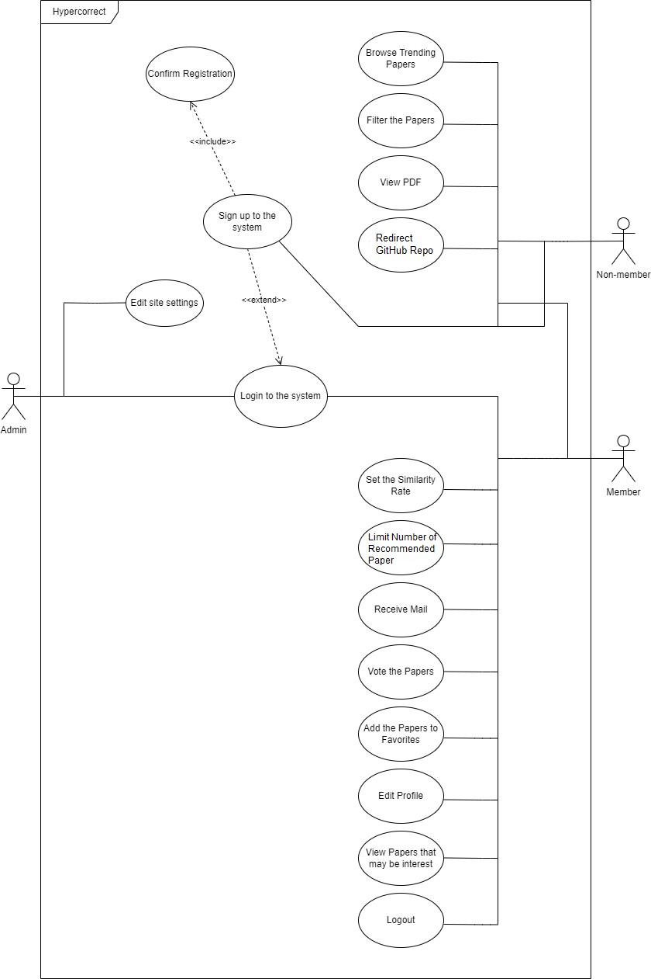
Use Case Diagram

Slide 19
07
Potential Risks

Slide 20






Potential Risks
The API system we pull data from may be shut down.
There may be a problem with the mail services.
If the number of papers added to the system is high, our resources for analysis are insufficient.
The pre-trained we will use to embed abstract and title may not work well enough.

Slide 21
08
Conclusion

Slide 22








It is a service provided by Hypercorrect to recommend papers that may be of interest to researchers, accompanied by their filters, and to send them via e- mail. Also, we aim to enabling users to find the papers they are looking for without wasting time.

Slide 23

References
http://cengproject.cankaya.edu.tr/templates/
https://slidesgo.com/theme/virtual-weekly-status-report#search-Business&position- 14&results-1491
https://sites.google.com/site/louismccallapcp/home/development/use-cases/use-
case%20diagram
https://papers.labml.ai/papers/weekly
https://huggingface.co/docs/transformers/model_doc/bert
https://github.com/UKPLab/sentence-transformers

Slide 24




Thanks!
CREDITS: This presentation template was created by Slidesgo, including icons by
Flaticon, and infographics & images by Freepik

